Slide 1
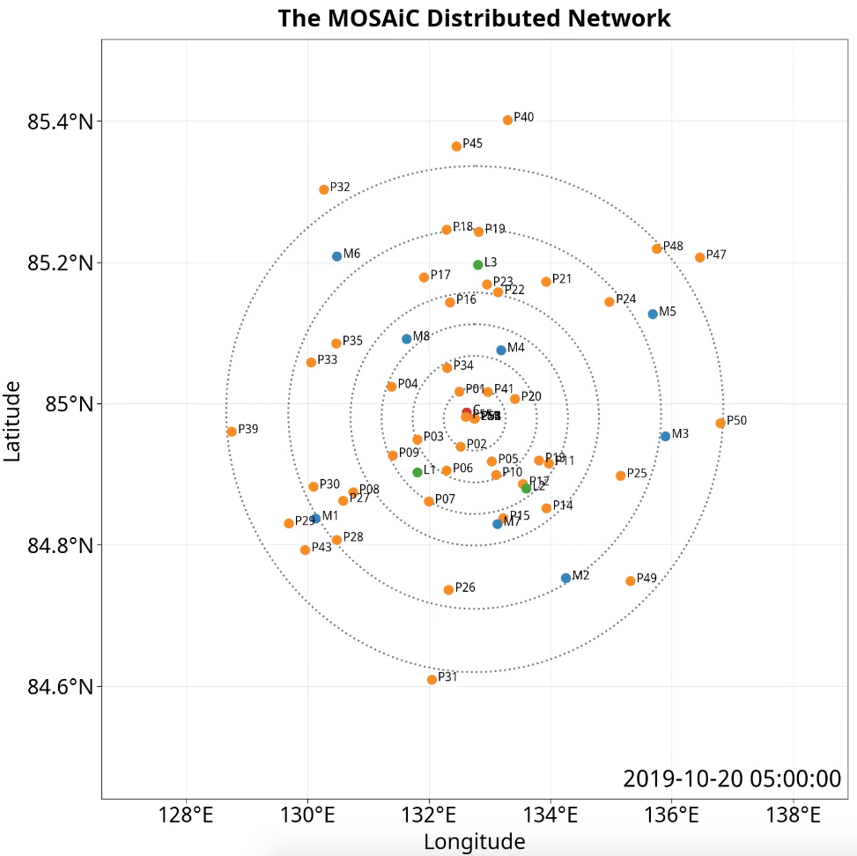
Deformation calculation for these arrays in calc_strain_longest_ts.pro
Notes:
We can look at many more spatial scales with this array.

Slide 2
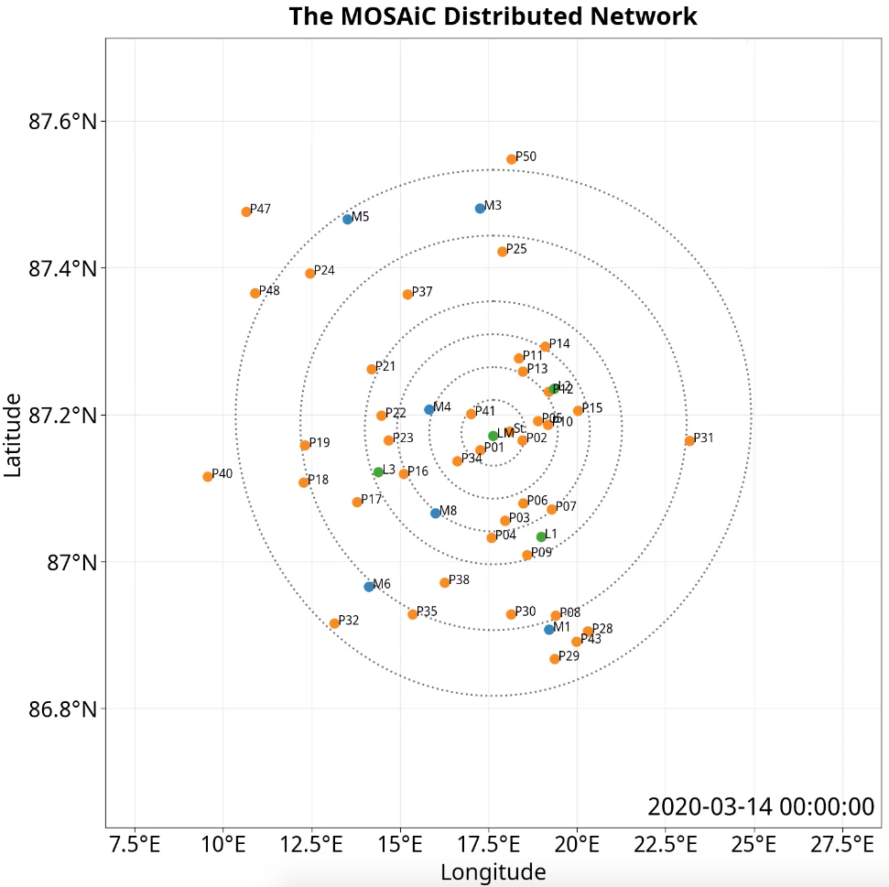
Notes:
Shearing of the distributed network in February and early March results in buoys losses. L1 and L3 ridged. Some buoys, e.g. P26 disappear and then reappear in May.

Slide 3
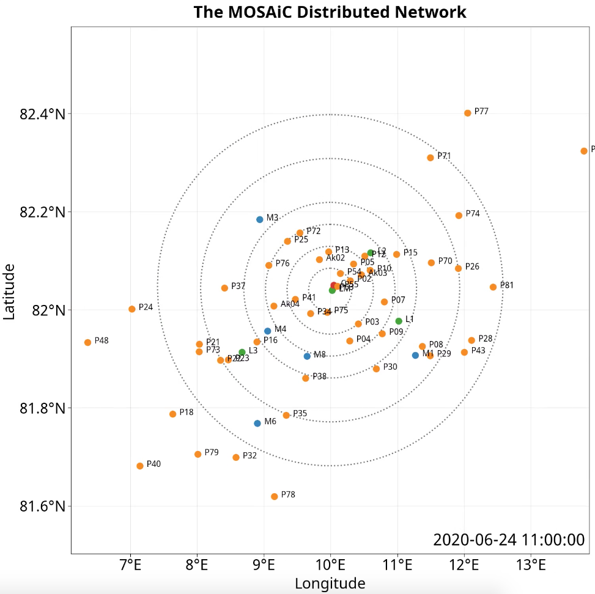

Slide 5
Lead opening and ridging are intermittent events
Notes:
Ridging or lead opening events roughly align across the array. However opening might be happening in one place where ridging is happening in another. In General there was opening over the months, however on the largest scale opening and ridging roughly cancelled until the array reached Fram Strait in June.
It is interesting that the events are wider at the larger spatial scales than the smallest scale. Could this be because individual events are sharp and distinct, but the response to a change in forcing happens over the time period that the weather system passes across the larger region? The deformation is intermitant. And hence it has a multifractal behaviour that reflects the localization in time and space (Rampal).

Slide 6
This is when leads were working in the vicinity of the Polarstern
Notes:
Ask Stefan and Robert Ricker when the transition in ridge heights and density occurred.

Slide 7
Varying dynamic regimes?
Notes:
There appear to be some different dynamics experienced throughout the drift.

Slide 8
New ridges not consolidating?
Consolidated
Inertial?
Locally
Active
Stormy
MIZ
Tides?
Consolidated?
Notes:
There appear to be some different dynamics experienced throughout the drift.

Slide 9
Choosing arrays in November
Shown on following slides. We do not use this data in the analysis, however decide to use arrays back tracked from June.
These arrays have deformation calculated by calc_strain_longest_ts_morev2.pro

Slide 10
57 triads
P13
Notes:
We can look at many more spatial scales with this array.

Slide 11
P13
Notes:
We can look at many more spatial scales with this array.

Slide 12
P13
Notes:
We can look at many more spatial scales with this array.

Slide 13
P13
Notes:
We can look at many more spatial scales with this array.

Slide 14
Choosing arrays in June
Shown on following slides.
These arrays have deformation calculated by calc_strain_longest_ts_more.pro

Slide 15
46 Triads

Slide 18
Old Slides
Drafts follow that show different configurations for other buoy arrays.

